Slide 1
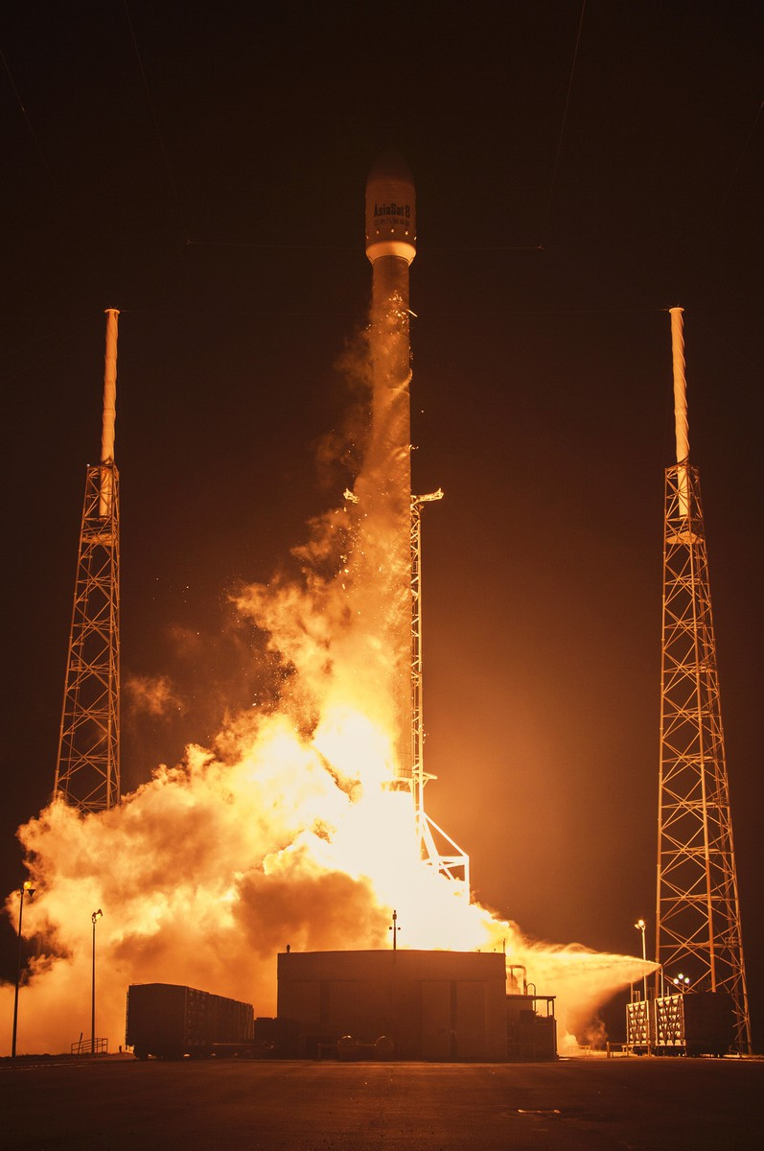
SpaceX Falcon-9 First stage landing prediction
IBM Data Science Capstone Project
By Binod Tamang

Slide 2

Executive Summary
01
Outline
02
Introduction
03
Methodology
04
Results
05
Conclusion
06
Appendix

Slide 3
Executive Summary
01
Collection
Data Wrangling
Exploratory Data
Predective Analysis By Machine Learning
EDA by Visualization

Slide 4
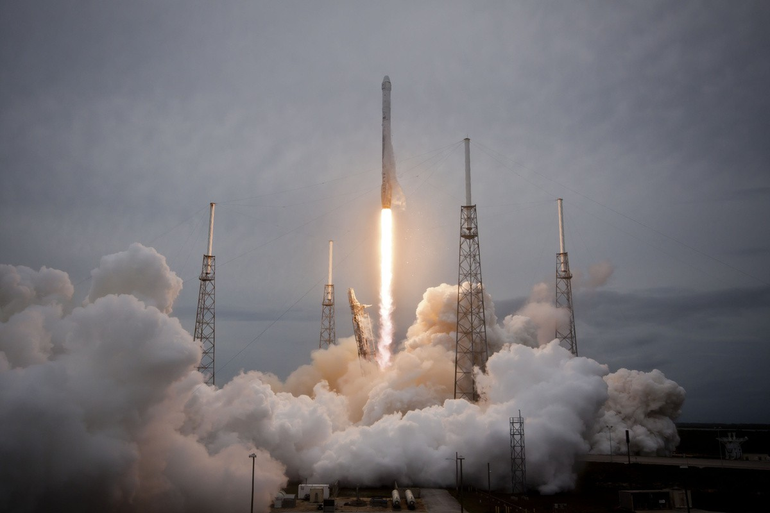

Introduction
02
SpaceX's Goal
Sending spacecraft to the international space station
Providing satellite internet to the whole world with Starlink technology
Taking people and cargo into space and contributing to space exploration.

Slide 5

FALCON 9 ROCKETS
02
Falcon 9 is a two-stage reusable rocket developed and manufactured by SpaceX, a private aerospace company founded by Elon Musk. Here are some key features and missions of Falcon 9 rockets
Reusability: One of the notable features of Falcon 9 is its reusability. The first stage of the rocket is designed to return to Earth after launch, landing vertically either on land (at SpaceX's landing zones) or on an autonomous drone ship in the ocean. This reusability significantly reduces the cost of space launches.
Payload Capacity: Falcon 9 is capable of delivering a variety of payloads to orbit, including satellites, cargo resupply missions to the International Space Station (ISS), and even crewed missions. It has a payload capacity of up to 22,800 kilograms (50,300 pounds) to low Earth orbit (LEO) and up to 8,300 kilograms (18,300 pounds) to geostationary transfer orbit (GTO).

Slide 6
Starlink: Falcon 9 plays a crucial role in SpaceX's ambitious Starlink project, which aims to provide global broadband internet coverage from a network of thousands of small satellites in low Earth orbit. Falcon 9 launches numerous batches of Starlink satellites to gradually build up the constellation.
NASA Missions: Falcon 9 has been selected by NASA for various missions, including resupplying the ISS as part of the Commercial Resupply Services (CRS) contract. Falcon 9 was also used to launch the Crew Dragon spacecraft, enabling NASA to resume crewed launches from U.S. soil.
Satellite Deployment: Falcon 9 is frequently used to deploy satellites for commercial customers, government agencies, and scientific research. It offers the flexibility to deliver satellites into different orbits, such as LEO, GTO, and sun-synchronous orbit (SSO).

Slide 7

Methodology
03

Slide 8

03
Data Collection methodology
Require the data from SpaceX API
Collect data from a Wikipedia page
Data Collection methodology
Perform EDA to find some problems Determine what would be the label for training
supervised learning
Perform exploratory data analysis (EDA) using visualization and SQL Perform interactive visual analytics using Folium and Plotly Dash Perform predictive analysis using classification models

Slide 9

Data Collection
03
API
spacex_url="https://api.spacexdata.com/v4/launches/past"
WEB PAGE
"https://en.wikipedia.org/w/index.php?title=List_of_Falcon_9_and_ Falcon_Heavy_launches&oldid=1027686922"

Slide 10
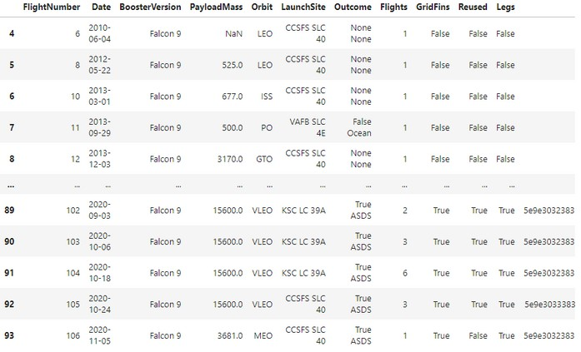
Data Collection - SpaceX API
03
Request and parse the SpaceX launch data using the GET request Filter the dataframe to only include Falcon 9 launches
Data Scraping - Wikipedia
Web scraping Falcon 9 and Falcon Heavy Launches Records from Wikipedia
Request the Falcon9 Launch Wiki page from its URL
Extract all column/variable names from the HTML table header Create a data frame by parsing the launch HTML tables

Slide 11
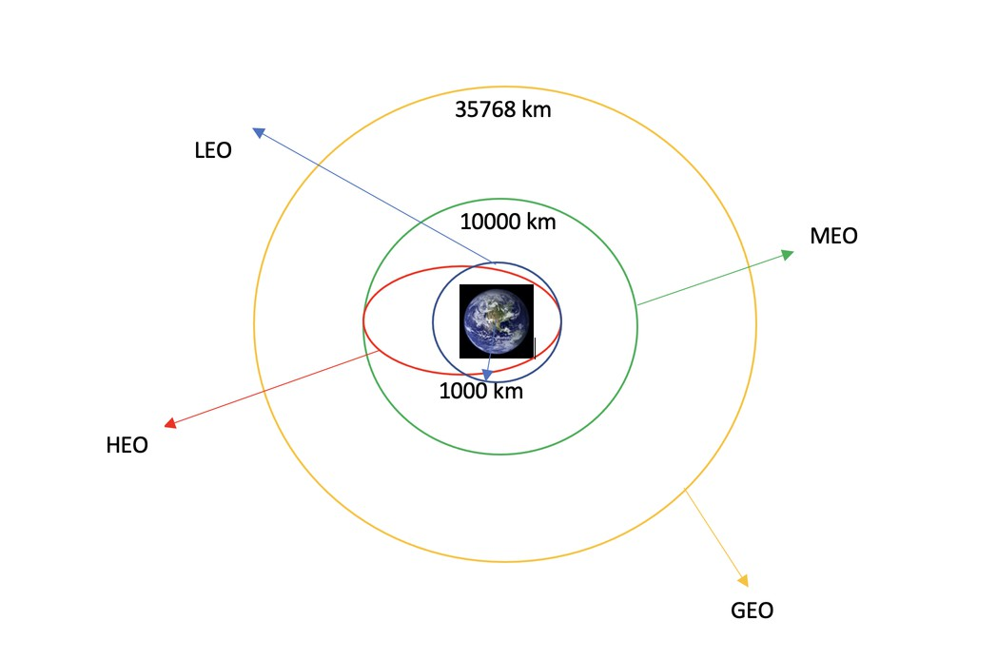
Data Wrangling
03
Calculate the number of launches on each site Calculate the number and occurrence of each orbit
Calculate the number and occurence of mission outcome per orbit type Create a landing outcome label from Outcome column

Slide 12
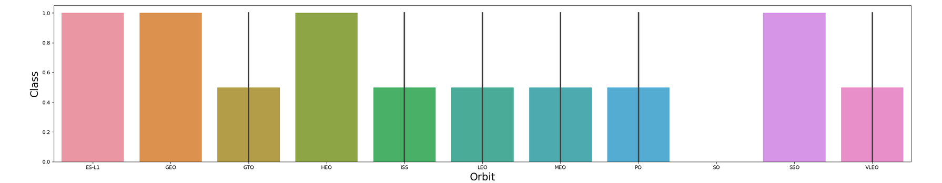
EDA with Data ViSualization
03
We can plot out the FlightNumber vs. PayloadMassand overlay the outcome of the launch
Visualize the relationship between Flight Number and Launch Site Visualize the relationship between Payload and Launch Site Visualize the relationship between success rate of each orbit type Visualize the relationship between FlightNumber and Orbit type Visualize the relationship between Payload and Orbit type Visualize the launch success yearly trend

Slide 13
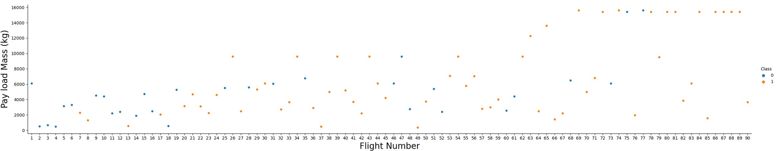
EDA with Data ViSualization
03
We see that different launch sites have different success rates. CCAFS LC-40,
has a success rate of 60 %, while KSC LC-39A and VAFB SLC 4E has a success rate of 77%.a

Slide 14
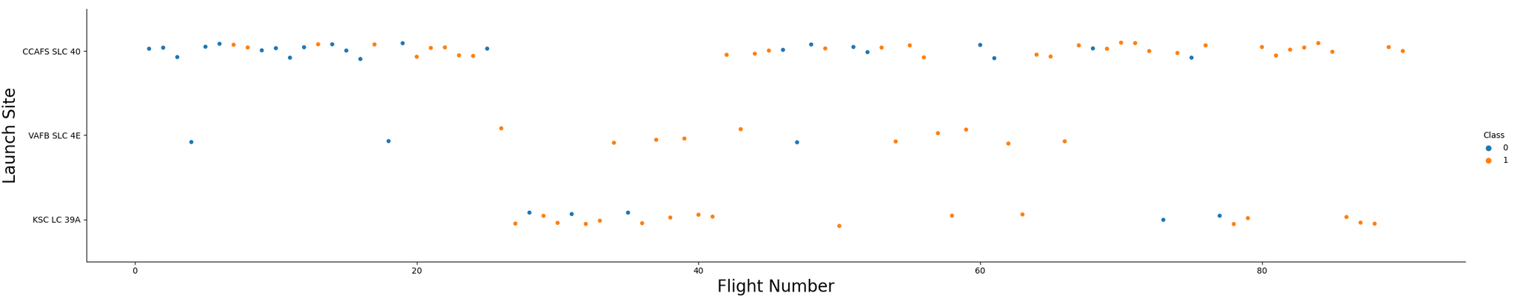
EDA with Data ViSualization
03
Use the function catplot to plot FlightNumber vs LaunchSite, set the parameter x parameter to FlightNumber, set the y to Launch Site and set the parameter hue to 'class'

Slide 15
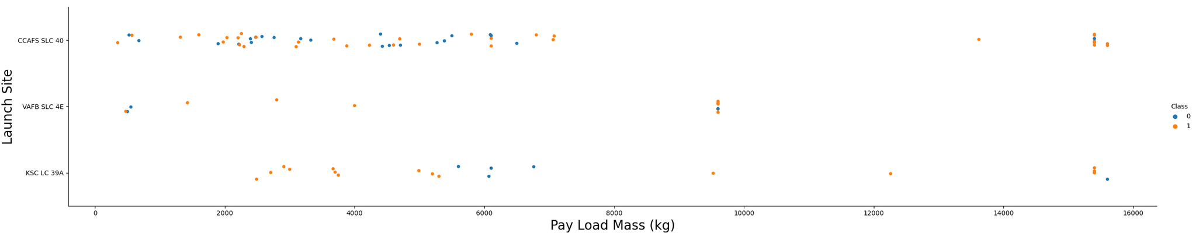
EDA with Data ViSualization
03
We also want to observe if there is any relationship between launch sites and their payload mass.

Slide 16

EDA with Data ViSualization
03
Visualize the relationship between success rate of each orbit type

Slide 17
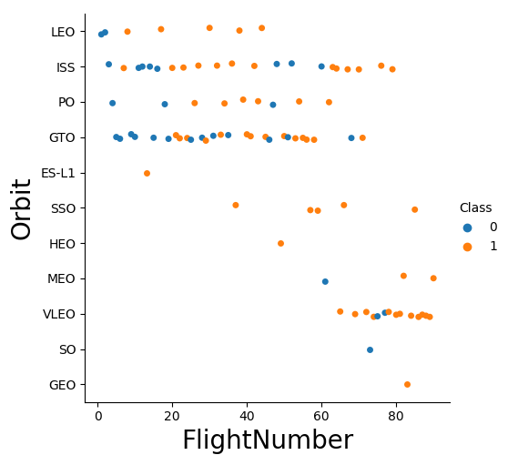
EDA with Data ViSualization
03
Visualize the relationship between FlightNumber and Orbit type

Slide 18
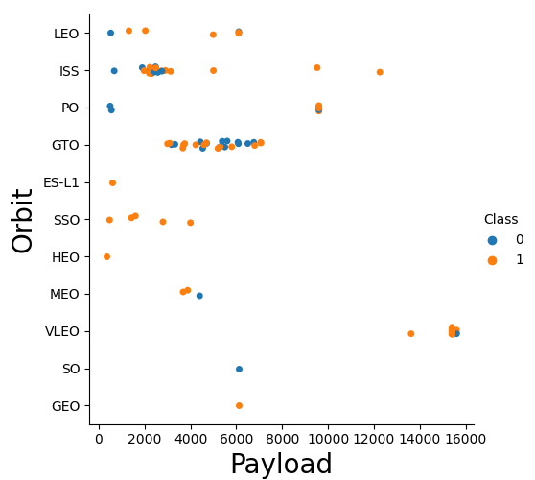
EDA with Data ViSualization
03
Visualize the relationship between Payload and Orbit type

Slide 19
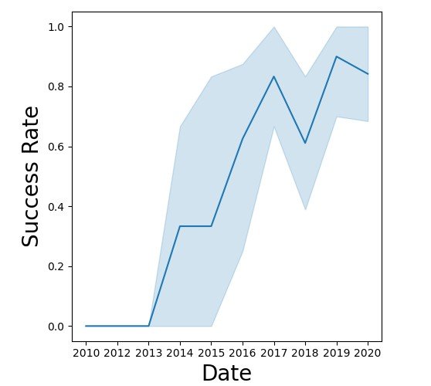
EDA with Data ViSualization
03
Visualize the launch success yearly trend

Slide 20
EDA with SQL
03
Display the names of the unique launch sites in the space mission Display 5 records where launch sites begin with the string 'CCA' Display the total payload mass carried by boosters launched by NASA (CRS)
Display average payload mass carried by booster version F9 v1.1
List the date when the first succesful landing outcome in ground pad was acheived.
List the names of the boosters which have success in drone ship and
have payload mass greater than 4000 but less than 6000
List the total number of successful and failure mission outcomes
List the names of the booster_versions which have carried the maximum payload mass. Use a subquery
List the records which will display the month names, failure landing_outcomes in drone ship ,booster versions, launch_site for the months in year 2015
Rank the count of successful landing_outcomes between the date 04- 06-2010 and 20-03-2017 in descending order.

Slide 21
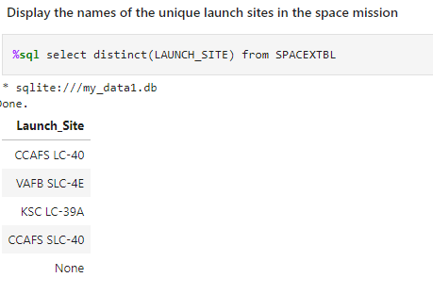
EDA with SQL
03
Display the names of the unique launch sites in the space mission

Slide 22
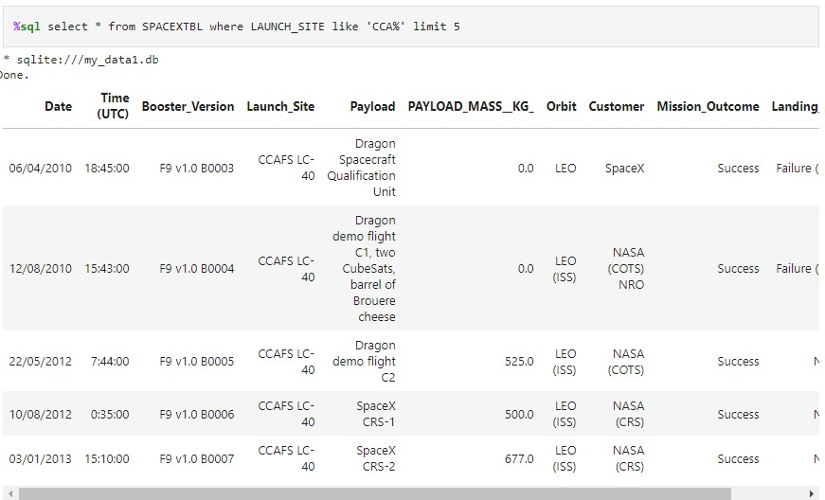
EDA with SQL
03
Display 5 records where launch sites begin with the string 'CCA'

Slide 23
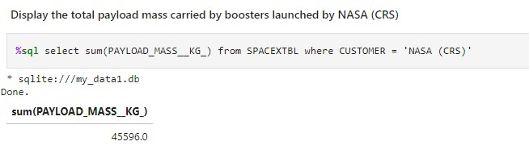
EDA with SQL
03
Display the total payload mass carried by boosters launched by NASA (CRS)

Slide 24
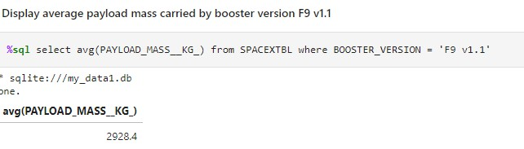
EDA with SQL
03
Display average payload mass carried by booster version F9 v1.1

Slide 25
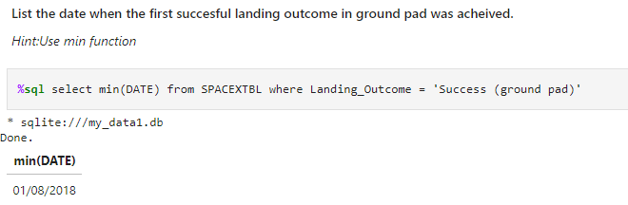
EDA with SQL
03
List the date when the first succesful landing outcome in ground pad was acheived.

Slide 26
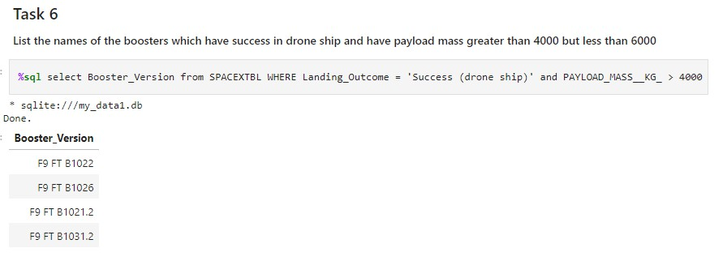
EDA with SQL
03
List the names of the boosters which have success in drone ship and have payload mass greater than 4000 but less than 6000

Slide 27
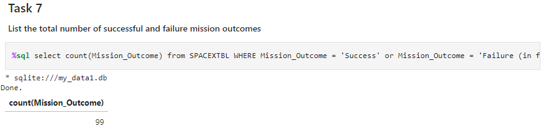
EDA with SQL
03
List the total number of successful and failure mission outcomes

Slide 28
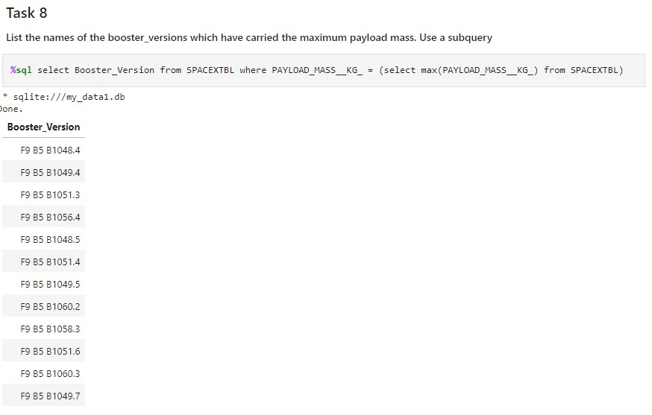
EDA with SQL
03
List the names of the booster_versions which have carried the maximum payload mass. Use a subquery

Slide 29
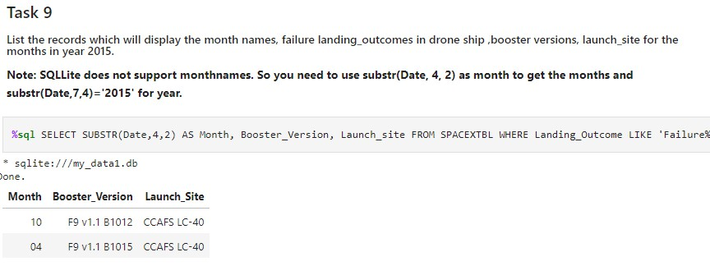
EDA with SQL
03
List the records which will display the month names, failure landing_outcomes in drone ship ,booster versions, launch_site for the months in year 2015.

Slide 30
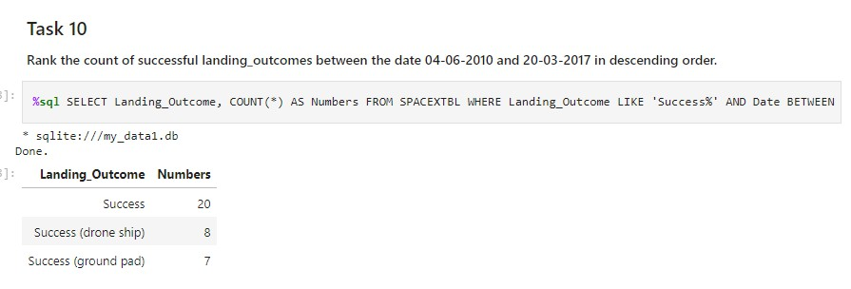
EDA with SQL
03
Rank the count of successful landing_outcomes between the date 04-06-2010 and 20-03-2017 in descending order.

Slide 31
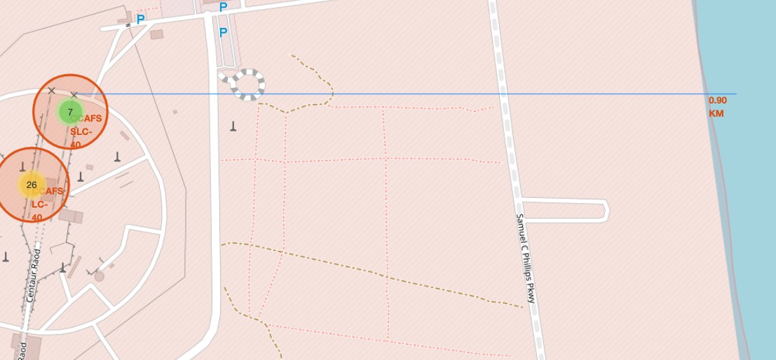
Interactive Visual Analytics with Folium
03
Mark all launch sites on a map
Mark the success/failed launches for each site on the map Calculate the distances between a launch site to its proximities

Slide 32
Machine Learning Prediction
03
Create a NumPy array from the column Class in data, by applying the method to_numpy() then assign it to the variable Y,make sure the output is a Pandas series (only one bracket df['name of column']).
Standardize the data in X then reassign it to the variable X using the transform provided below.
Use the function train_test_split to split the data X and Y into training and test data. Set the parameter test_size to 0.2 and random_state to
2. The training data and test data should be assigned to the following labels.
Create a logistic regression object then create a GridSearchCV
object logreg_cv with cv = 10. Fit the object to find the best parameters from the dictionary parameters.

Slide 33

Machine Learning Prediction
03
We output the GridSearchCV object for logistic regression. We display the best parameters using the data attribute best_params_ and the accuracy on the validation data using the data attribute best_score_.
Calculate the accuracy on the test data using the method score:
0.8333333333333334

Slide 34
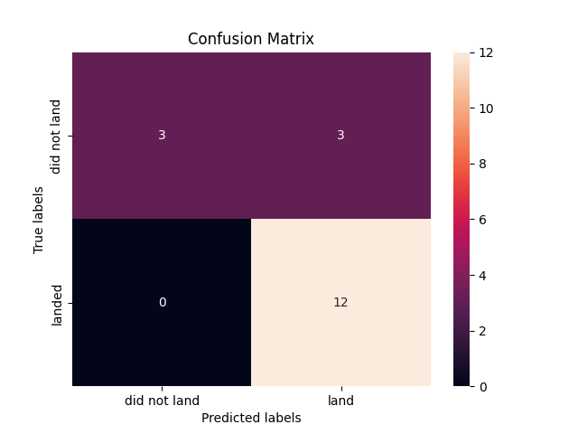
Machine Learning Prediction
03

Slide 35
Machine Learning Prediction
03
Create a support vector machine object then create a GridSearchCV object svm_cv with cv - 10. Fit the object to find the best parameters from the dictionary parameters.
accuracy : 0.8482142857142856
Calculate the accuracy on the test data using the method score:
0.8333333333333334

Slide 36
Machine Learning Prediction
03
Create a decision tree classifier object then create a GridSearchCV object tree_cv with cv = 10. Fit the object to find the best parameters from the dictionary parameters
accuracy : 0.8714285714285713
Calculate the accuracy of tree_cv on the test data using the method score:
0.8333333333333334

Slide 37
Machine Learning Prediction
03
Create a k nearest neighbors object then create a GridSearchCV object knn_cv with cv = 10. Fit the object to find the best parameters from the dictionary parameters
accuracy : 0.8482142857142858
Calculate the accuracy of knn_cv on the test data using the method score:
0.8333333333333334

Slide 38

03
Machine Learning Prediction
"Practically all these algorithms give the same result"

Slide 39

ConcluSion
Konu 05
There is a correlation between launch site and success rate Payload mass is also associated with the success rate.: the more massive the payload, the less likely the first stage will return
For orbit type, SO has the least success rate while ES-L1, GEO, HEO and SSO have the highest success rate According to the yearly trend
There has been an increase in the success rate since 201 3 kept increasing till 2020 • With best parameter provided, decision tree classifier used in prediction yielded the highest accuracy of 84% .

Slide 40

Thank you!

Slide 41

Appendix ReSourceS

